Slide 1
KENNETH NYANGWESO DSF PHASE 1 PROJECT
ANALYSIS ON AVIATION ACCIDENTS DATASET

Slide 2
PROJECT OVERVIEW
This project outlines the analysis based on a dataset provided by the National Safety and Transport Board that relayed data on aviation accidents over the past decades (1962-2022).
Many factors have influenced the rates of accidents over the past decades such as; aircraft make, aircraft model, and how their correlation has contributed to aviation accidents.
My analysis is based on various types of makes, and models, and their influence on aviation accidents - based on their accident counts.
My analysis will also be based on regions that have recorded the highest number of accidents.
Finally we will also be able to see the accident patterns over the past decades.

Slide 3
OBJECTIVES
Main objective:
To analyze and interpret accident trends over the past decades
Specific objectives:
Identify factors that have led to aviation accidents based on aircraft parameters such as make, model, their correlation, and aircraft category
Identify factors that have led to aviation accidents region-wise based on countries and accidents recorded in various regions
How various makes have made an impact on various based on injuries recorded from each make..
Identify the trends yearly over the past decades based on aviation accidents

Slide 4
MY ANALYSIS
This analysis will be based on the top key factors that influence aviation accidents these parameters are:
Top 10 aircraft makes with the most aviation accidents
Top 15 aircraft models with the most aviation accidents
Top 5 aircraft categories with the most aviation accidents
Top 5 main Broad phase of flight with the most accidents
Top 5 countries with the most aviation accidents
Top 5 makes with total number of injuries recorded
Top 3 aircraft makes and models and how their correlation have impacted aviation accidents
The trend of aviation accidents over the past decades

Slide 5
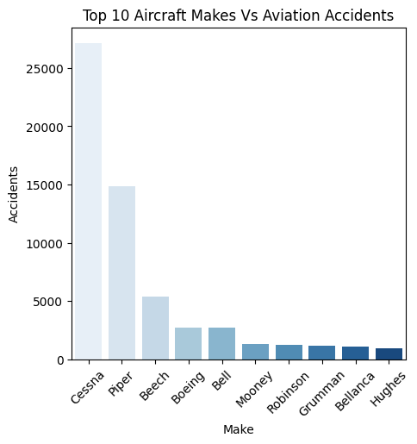
AIRCRAFT MAKE VS ACCIDENTS
Notes:
From my analysis it is evident that the aircraft with most recorded accidents are the Cessna and Piper as each of these makes record more than 10000 accidents.

Slide 6
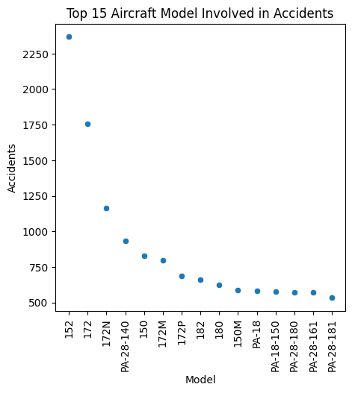
AIRCRAFT MODEL VS ACCIDENTS
Notes:
From the above analysis we see the top models with the most accidents are the 152, 172 and 172N

Slide 7
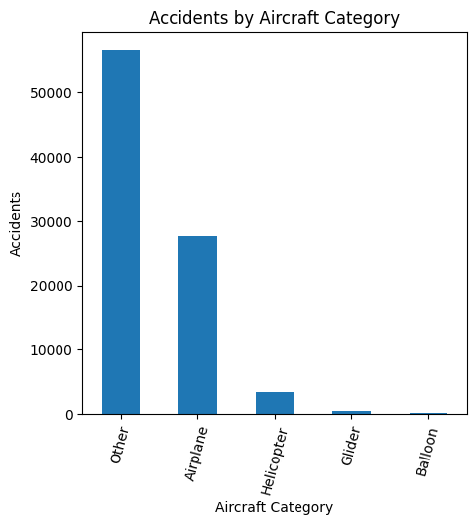
AIRCRAFT CATEGORY VS ACCIDENTS
Notes:
From the above analysis we see that the lead accidents as per category are other aircrafts. This may include the single engine crafts as their makes such as Cessna and piper lead the pack when it comes to the most number of accidents recorded.

Slide 8
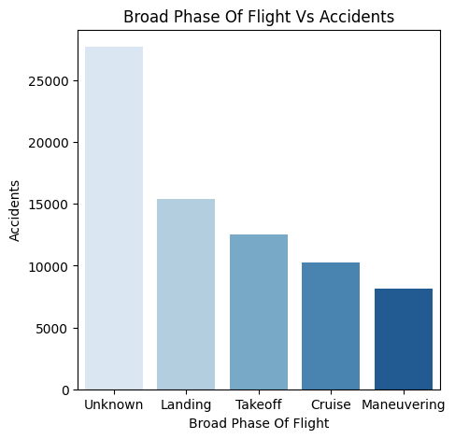
BROAD PHASE OF FLIGHT VS ACCIDENTS
Notes:
It is evident that most accidents that occur during these phases are unknown. Such may include approach, climb or even taxing.

Slide 9
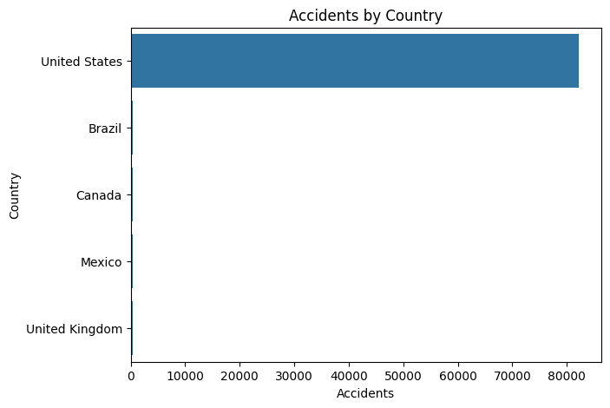
COUNTRIES VS ACCIDENTS
Notes:
It is evident that most accidents occur on United States of America as accidents recorded for this region exceed 80000 as compared to the other top five countries.

Slide 10
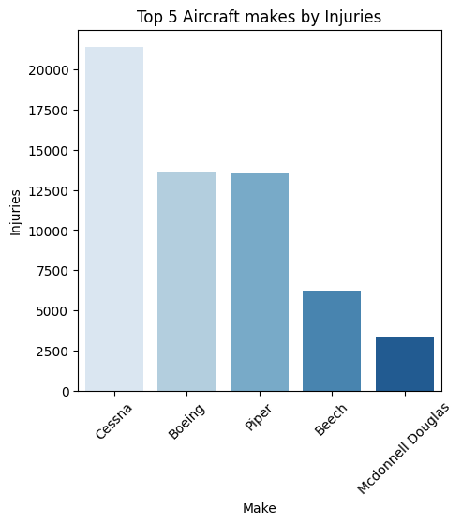
MAKE VS INJURIES
Notes:
This analysis provides further insights on what make has the highest number of injuries which implies that the Cessna and Boeing have the most number injuries

Slide 11
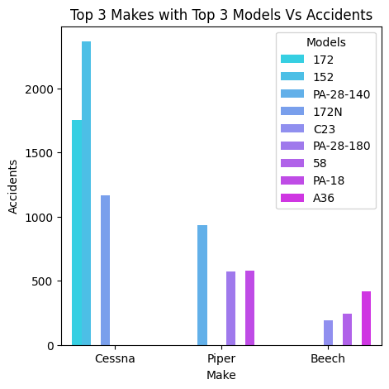
MAKES AND MODELS VS ACCIDENTS
Notes:
The above analysis gives insights on certain aircraft makes accidents based on their model types.

Slide 12
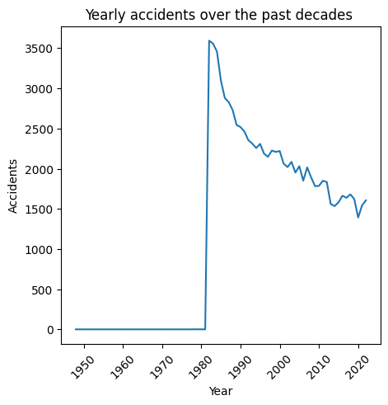
YEARLY ACCIDENTS
Notes:
It is evident in this analysis that as of 1980 accidents rapidly increased and as time progressed there has been a decrease in aviation accidents

Slide 13
FINDINGS
After doing a keen analysis and coming up with an interpretable analysis I was able to provide findings based on grouping certain factors.

Slide 14
FINDING BASED ON MAKE, MODEL AND CATEGORY OF THE AIRCRAFTS
From my analysis, it is evident that the Cessna and Piper have the most number of accidents with each having a record exceeding 10,000. I went further with my analysis by checking how this can be influenced by the model. From my analysis, the models that record the most accidents are the 152, 172, and 172N models with more than 1000 aviation accidents. These key models are widely used by the Cessna and Piper companies hence contributing to these aviation accidents.
It is also evident that most aircraft categories with the most accidents are the unspecified ones. We can assume that these air the single engine planes category which are widely used by the Cessna and Piper makes.

Slide 15
FINDINGS BASED ON BROAD PHASE OF FLIGHT
From my analysis the phase of flight where accidents occur is unknown/unspecified. With reference from my previous based on make and aircraft category my research has given insights that most of these aircraft weight are light and have trouble during the climb phase which was unspecified in my analysis. Hence we can assume that the most recorded accident is during the climb phase since most aircraft makes with most accidents are quite sensitive when it comes to this phase of flight.
Also from my analysis the landing, take-off and cruise phases have recorded accidents exceeding 10000. This may be brought about by factors such as pilot error, Air Traffic Control Errors(ATC) , maintenance and many others.

Slide 16
FINDINGS BASED ON COUNTRY
From my analysis it is evident that the United States of America has recorded the highest number of accidents with a whooping 80,000. This can brought about by factors such incompetent engineers, busy airports or even poor weather conditions in this certain region.

Slide 17
FINDING BASED ON INJURIES
It is evident that from my analysis the Cessna, Boeing and the Piper lead the pack. We can ask ourselves why is Boeing at the top yet it recorded least number of accidents? This can be brought about by factors such large impact maybe during a plane crash due to massive aircraft weight or mid air-collision (example is the 1996 mid-air collision when a Boeing 747-168B collided with an Ilyushin airline leading 200 total fatalities) or even due large fuel capacities that cause massive fires during impact.

Slide 18
FINDINGS YEARLY
From my analysis it is evident that there was a rapid increase of aviation accidents as of early 1980s. However as time progress we can see a rapid decrease in aviation accidents. This may be brought about by factors such as technological advancements such as the autopilot, adequate aviation personel trainings such as ATC training and regular aircraft maintenance and inspections.

